Slide 1

THE ICFAI UNIVERSITY TRIPURA
Department of computer science and engineering
Project report on job nest
Course code- sip201
Course title- summer internship program ii
Program- cse, 2nd year
Faculty of science and technology
Guided by- professor soumen ghosh
Submitted by:
Name: roll no:
Manisha roy 20iut0020235
Anuj saha 20iut0020234
Uttaran roy 20iut0020237
Papiya das 20iut0020127

Slide 2
PROJECT- JOB NEST
DESCRIPTION
An online job portal is an application where the job seekers can register themselves at the website and search jobs which are suitable for them. the main purpose of this project is to develop an online job portal where applicants easily find jobs. The system project is an online web application which can be accessed anywhere only with proper login provided.
LANGUAGE USED
frontend- angular which includes HTML, CSS, JavaScript, Jason, rest.
Backend- Python which includes mongo DB, encryption, compression, JSON, rest.

Slide 3

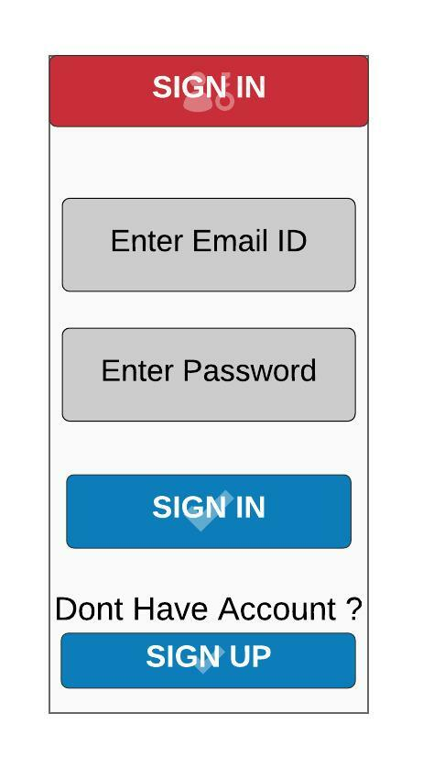
WIREFRAME
Launch Screen: Here we will see the sign in and sign up Buttons. For the first time login you have to sign Up and if you are already a user then you can just sign In.
Sign In page: Here we have to enter the Email Id and password to sign In and if you don’t have any account then you can go to sign Up page from here only. After signing in you will go to the Home page.

Slide 4
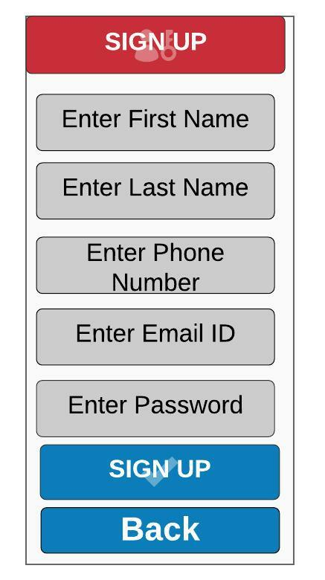
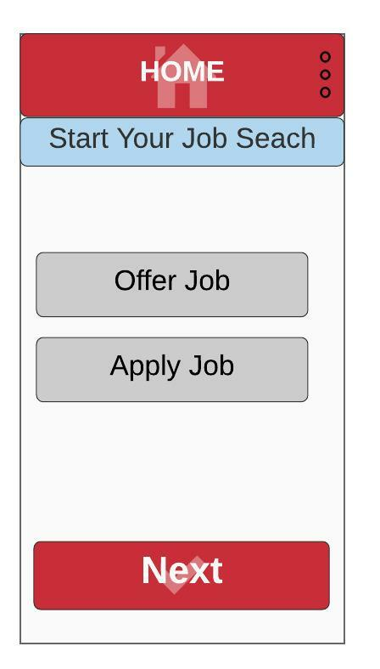
WIREFRAME
Sign Up page: For the first time log in you have to fill the Sign Up page with the First name, Last Name, Phone No. Email Id and give the password, then you will be redirected to the Home page.
Home Page: The Home page have a search bar, Offer Job, Apply Job and Setting Button

Slide 5
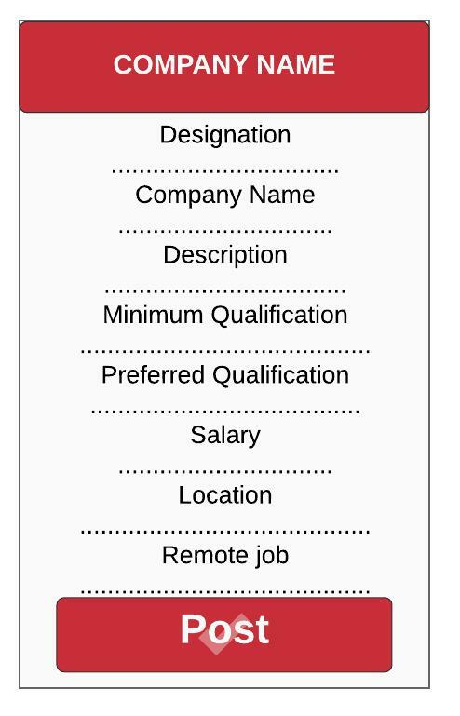
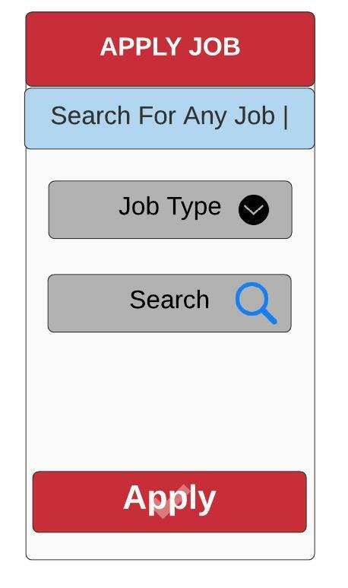
WIREFRAME
Offer Job page: Here we will give the Designation of Job, Company Name, Company Details , etc. and post this, so that the job seekers can get a minimal idea about the company. After posting the job we will be redirected to submitted application page.
Apply Job page: Here we have the Search Bar, Job Type selection category. The appliers can find the Jobs here with a very simple way as their own preferences and Apply for it. After Applying the job we will be redirected to submitted application page.

Slide 6
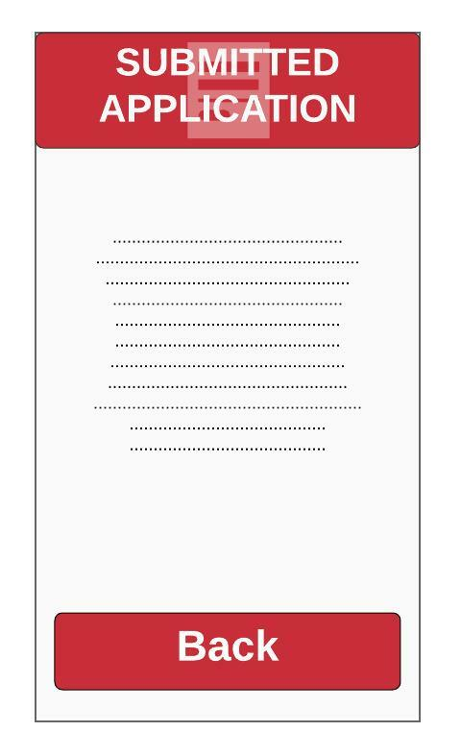
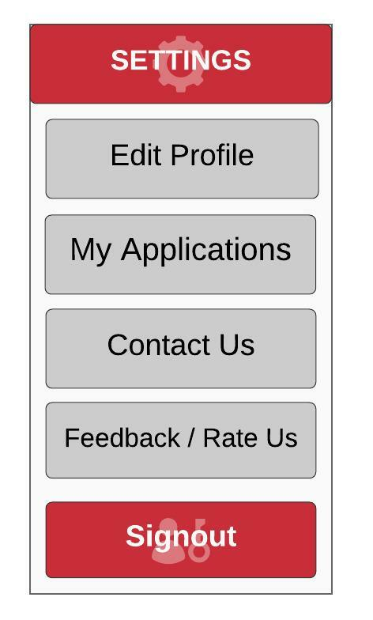
WIREFRAME
Submitted Application page: Here we will see the submitted applications of any Posted or Applied Jobs. The Back Button will redirected to the Home Page.
Settings page: In the settings page we can edit our profile, look at our Applications, Contact the Developers and Rate/Feedback us. We can also Sign Out from the settings page at one tap.

Slide 7
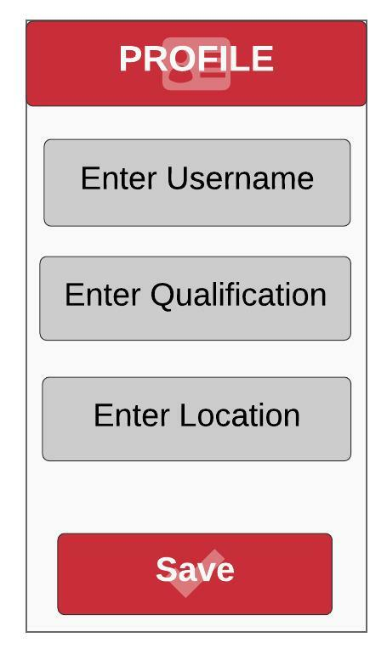
WIREFRAME
Profile Page: In the profile page redirected from settings menu, we will provide our Username , Enter Qualification, Location or Address and save It. After saving we will be redirected to the Home Page.

Slide 8
WIREFRAME

Slide 9
CONCLUSION
The wider areas of job searching facilitate the quick and easy access two opportunities. The increasing job opportunities and changing scenario of the business environment today has made more people to search for better career.

